Slide 1





CMMC Tele Sales Campaign Readiness March 2021
Microsoft Internal Only

Slide 2
Agenda
Session 1:
Campaign Introduction
Defense Industrial Base
Cybersecurity Maturity Model Certification
Campaign Execution
Session 2:
Questions / follow-up from session 1
Common scenarios
Commercial vs. Government Clouds
Microsoft Security and Compliance Resources for CMMC

Slide 3
Campaign Introduction
Microsoft Internal Only

Slide 4
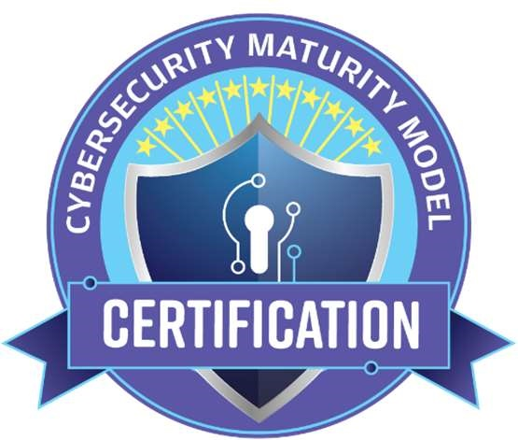
Campaign Introduction
Compelling event for 350K companies in the defense industrial base
Proactive outreach to connect companies to Microsoft partners
Aligned with the Microsoft cloud and security/compliance services
Drive ACR and E5 uplift across commercial and government clouds, especially across a new segment of companies
Microsoft Internal Only

Slide 5
Defense Industrial Base
Microsoft Internal Only

Slide 6

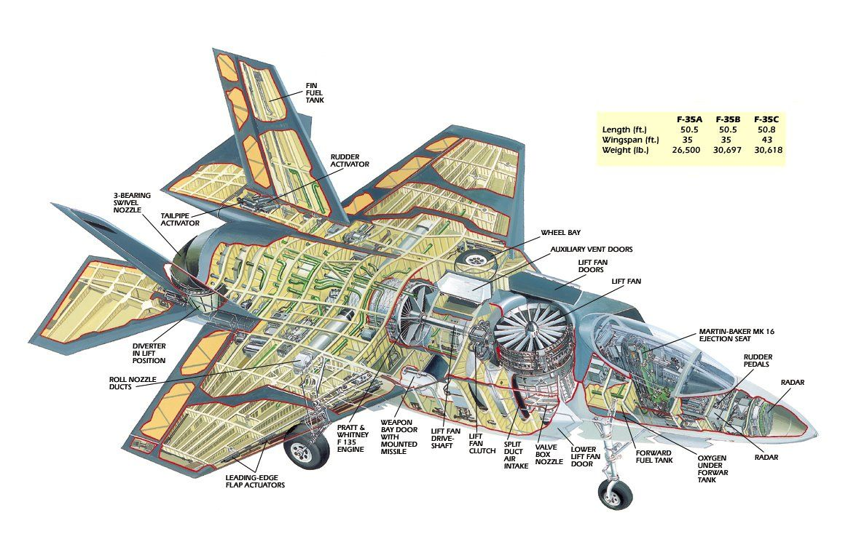

What is the Defense Industrial Base?
US Department of Defense
>2.8M employees
FY19 budget of $695B
Cybersecurity budget is increasing
Defense Industrial Base
Commercial organizations that are of direct or indirect importance to the production of equipment or providing services for our armed forces
Heavily represented by the Defense and Aerospace industry segments but also extends to academic institutions and beyond (Microsoft is part of the DIB)
From the largest of global manufacturers…
…to the smallest (e.g. <20 people)
AKA: Defense supply chain
Microsoft Internal Only
Notes:
During COVID, unlike many segments that have had to pull back/reduce budget, the US federal government has expanded
Cybersecurity, specifically, has increased budget (this crosses political lines and remains a top priority for the administration)
The DoD does not manufacture/provide its own equipment – commercial companies do:
Planes, tanks, ships
Drones, helicopters, trucks
Computers, radios, satellites
Buildings, roads, uniforms
Food, water, medical

Slide 7
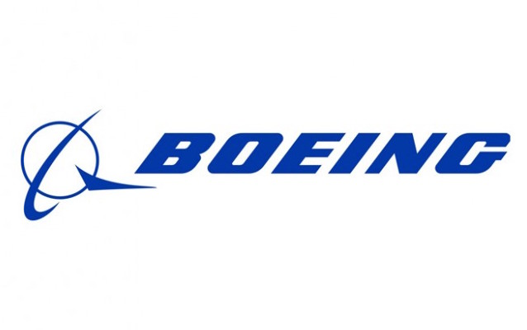

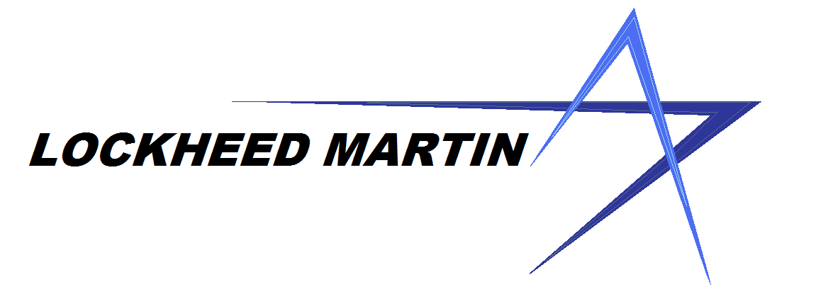
Who are the DIB?
Industries
Aerospace
Manufacturing
Telecommunications
Academic
Software
Professional Services
…almost all of them?
Large
Medium
Small
~350K companies
~80% of the DIB are small/medium
Note: No convenient place to see everyone in the DIB. Wikipedia has this list of “top 100” – consider it informative but imperfect
Microsoft Internal Only

Slide 8
Prime and Subcontractors
Government Entity (e.g. DoD)
Submits Requests for Information (RFI) and Requests for Proposal (RFP) to have products produced/services rendered
Contractors bid
Winners are awarded the contracts
Sub
Prime
Sub
Sub
(Small Business)
Sub
Primes
Contracted directly by the government
Can subcontract work to subcontractors (hundreds to 1000+)
Responsible for ensuring work meets contract requirements
Government
Sub
Prime
Sub
Subcontractors
Contracted by Primes (not the government)
Can further subcontract with other subcontractors
May have minimal visibility into the original contract details
Sub
(Small Business)
These terms are interchangeable: Contractors = Suppliers = DIBs
Microsoft Internal Only

Slide 9
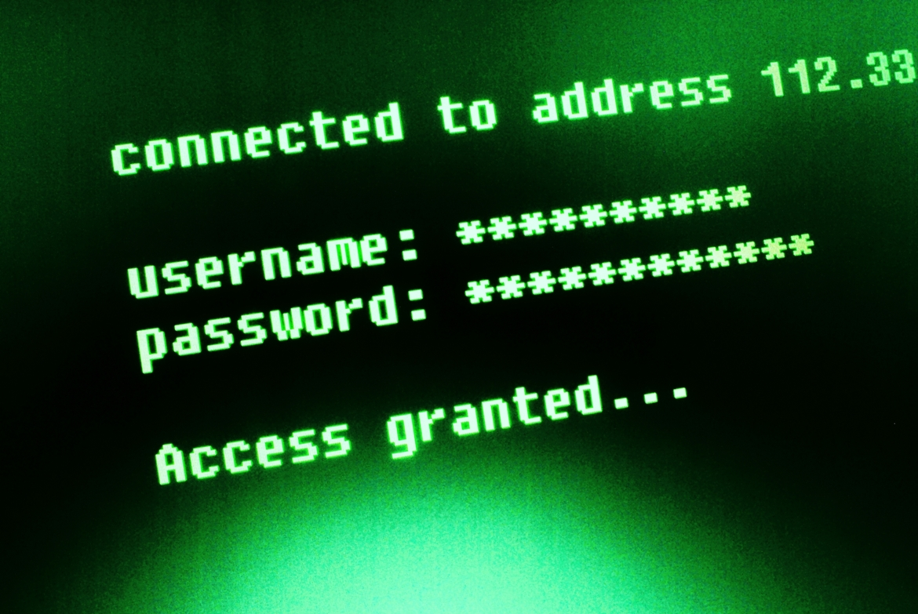

Defense Industrial Base
US DoD
Supply chain for the US Department of Defense
Commercial
Commercial companies manufacturing and providing services
350K
350K companies -
80% are small/medium
Under constant attack
Risk to national security
$5.1T at risk over next 5 years¹
¹ “Ninth Annual Cost of Cybercrime Study” by Accenture in 2019
Microsoft Internal Only
Notes:
US Department of Defense (DoD)
Over 2.8 million employees (1.3M+ are active duty service members)
FY19 budget was $695 billion
Defense Industrial Base (DIB)
The 350K commercial companies that make up the supply chain for the DoD
Heavily represented by the Aerospace and Defense sector although the full scope encompasses almost all sectors
Largest primes (Lockheed Martin, General Dynamics, Raytheon) down to 20-50 person companies
Consider small manufacturing companies building the widgets that are assembled into weapons systems like jet fighters, naval ships, tanks, etc.
Even includes food services and everything else required to operate a 2.8M person organization
Why do we care?
The DoD and its supply chain are under constant attack from nation states and other bad actors
Theft of sensitive information (e.g. weapon systems designs) poses risks to national security and significant monetary losses
Accenture 2019 study estimated $5.1T of revenue at risk over the next 5 years

Slide 10
Summary
The Defense Industrial Base (DIB), aka the defense supply chain, represents the commercial companies that produce equipment or provide services in support of the US Department of Defense
350K companies, 80% of which are small/medium
Prime contractors work directly against DoD contractors - they subcontract work to subcontractors
The DIB is under constant threat of attack – this results in lost money and threatens our national security
Our campaign is primarily focused on the small/medium DIBs (see CMMC Campaign section for more details)
Smaller companies are less likely to have the necessary IT and cybersecurity skills and resources to meet government requirements (e.g. CMMC)
Partners are key to support these companies (see CMMC Campaign section for more details)
Microsoft Internal Only

Slide 11
Terms
Term | Notes
DIB | Defense Industrial Base Primarily commercial companies that produce services or provide services in support of the DoD’s missions AKA: Defense supply chain, supply chain
Contract / Award | In this context, a contract is a formal description of work that the government is asking the DIB to produce/provide. AKA: Award. A contract is awarded to contractors. People may say “This award requires that we do X, Y, Z”. The term is interchangeable with “contract” in this context. AKA: “Contract vehicle” is another term sometimes used in place of “contract”. Note: There are different types of contracts (IDIQ, FFP, etc.). Probably don’t need to be intimately familiar with this for the campaign.
Prime / Prime Contractor | Commercial contractor that contracts directly for a government entity. Are generally larger organizations and will typically subcontract portions of work to subcontractors.
Sub / Subcontractor | Commercial contractor that contracts with a Prime (not directly with the government). Subcontractors can further subcontract with other subcontractors.
Small Business | Many government contracts have explicit requirements to include “small businesses” for portions of the work. Keep this in mind as it may be a factor in why certain smaller DIBs are included in contracts.
Microsoft Internal Only

Slide 12
Cybersecurity Maturity Model Certification
Microsoft Internal Only

Slide 13
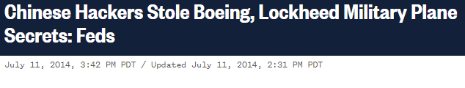
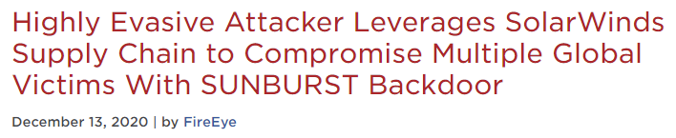
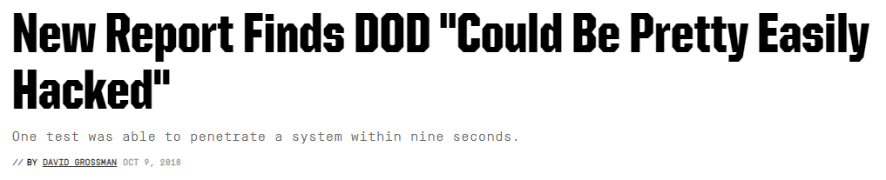
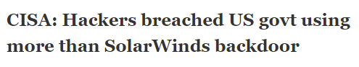
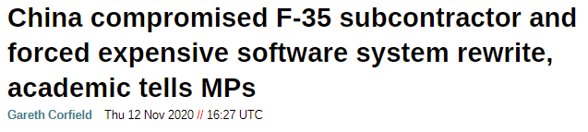
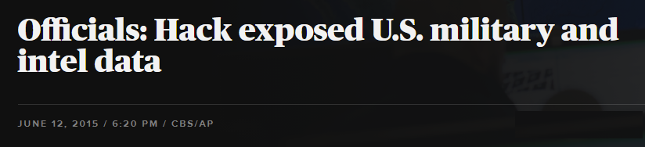
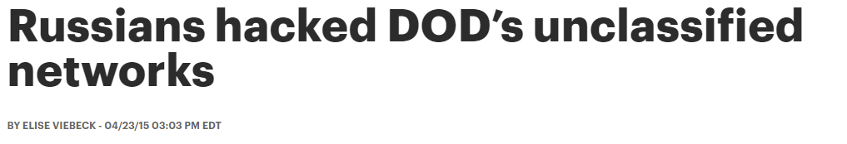
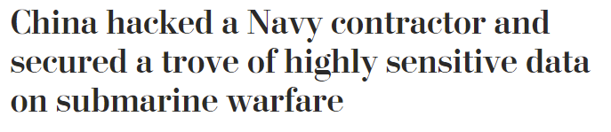
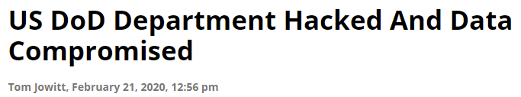
Headlines
Microsoft Internal Only
Notes:
Cybersecurity breaches are not theoretical

Slide 14
Safeguarding the Government’s Information
Type | Description | Notes
FCI | Federal Contract Information Information provided or generated under a government contract to develop or deliver a product or service. This information is not intended for public release. | Customers with FCI are at least CMMC level 1 and are aligned to our commercial clouds
CUI | Controlled Unclassified Information. Typically pronounced “C-U-I” (each letter spoken individually) OR “kooey” (as in Huey, Dewey, and Louie, the nephews of Donald Duck) Data that must be controlled/protected to prevent unauthorized disclosure. It can be provided by the government (typically via a contract) or can be produced as part of the output of working on a contract. | Customers with CUI are at least CMMC level 3 and are aligned to our government clouds. Examples: Technical designs, email or other communications, research data, engineering data, specifications, manuals, source code, and so on (go here for a complete list of CUI categories) CUI’s broad definition can make it challenging for organizations to be certain if they store/handle CUI. This further increases the chances of exposure beyond what’s intended.
ITAR | International Trade in Arms Regulations. Regulates the export of defense and military related technologies. | Customers with ITAR are at least CMMC level 3 and are aligned to our government clouds. Examples: Any item, software, or technology that is specifically intended for military or intelligence applications.
Public
FCI
CUI
Classified
Microsoft Internal Only

Slide 15



Existing Regulatory Landscape
DFARS
DFARS 7012 requires application of cybersecurity practices across DoD acquisitions
NIST
NIST 800-171 describes 110 cybersecurity controls aligned with DFARS 7012
Honor System
Contractors self-attest – many with open action items which leaves them exposed
This is a simplified view only. There are many more regulatory/compliance requirements that affect the DIB.
Microsoft Internal Only
Notes:
Open action items are typically tracked in a POA&M (Plan of Action and Milestones) document.
POA&M is pronounced “poe–am” – as in Edgar Allen Poe and I am hungry
The document describes tasks needed in order to meet outstanding compliance requirements
It is relatively common for companies to have open POA&M items (regardless that they should be closing them in a timely manner)
CMMC does not allow for open items – i.e., companies will likely need to take on work that they may have been holding off for a while due to complexity/costs

Slide 16
Fun with Acronyms and Numbers
FAR
SPRS
FAR | Federal Acquisition Regulation
DFARS | Defense Federal Acquisition Regulation Supplement - focuses on cybersecurity
DFARS 7012 | Full clause number: 252.204-7012 DoD-specific language on safeguarding sensitive data and cybersecurity incident reporting Contracts explicitly state whether DFARS 7012 applies (may not if only non-sensitive work needs to be done)
NIST 800-171 | Cybersecurity controls aligned to 7012 – lists the 110 controls that companies need to meet to comply with 7012
CMMC | New maturity model, added controls, and certification
SPRS | Supplier Performance Risk System. DoD system that records assessment scores by contractors. DFARS 7012 interim rule change included a new requirement that all DIBs record a score as part of bidding on contracts.
DFARS
Other Supplements
7012
Other Clauses
NIST 800-171
CMMC
Microsoft Internal Only
Notes:
Intent of this slide is to provide a simple, high-level overview of some of the key regulatory/compliance-related elements that are most relevant to our CMMC campaign
Should not be necessary to be intimately familiar with all the above
Just need to be familiar with the terms and how they generally fit together

Slide 17
Cybersecurity Maturity Model Certification
New Rule
CMMC rolling out now (over next 5 years)
DIB
Applies to every supplier in the DIB
Certified
Verified via Certified 3rd Party Assessor Organizations (C3PAOs)
Expect to see CMMC adopted more broadly across the Federal government
Microsoft Internal Only
Notes:
CMMC formally adopted on Nov 30, 2020 as part of an update to DFARS 7012
https://www.federalregister.gov/documents/2020/09/29/2020-21123/defense-federal-acquisition-regulation-supplement-assessing-contractor-implementation-of
Note, this also requires DIBs to record their NIST 800-171 assessment scores in the government’s SPRS system
Builds upon existing NIST 800-171 by introducing additional practices, 5 levels of maturity, and enforcement via 3rd party audits
The 3rd party audit is among the most significant aspects of CMMC; previous compliance requirements were more based upon the “honor system”
Applies to any company that stores/handles FCI data
If a company is 100% COTS (commercial off the shelf) and has no visibility into FCI (and by implication CUI or ITAR), then CMMC is not applicable
CMMC will rollout over the next 5 years
Limited pilot contracts in 2021
New awards begin requiring CMMC in 2022
And so on till 2025 where expectation is all awards will include it (due to renewals, application of new TOs, etc.)
Applies to all primes and their subs contracting with the DoD
“Flow down” requirements mean prime contractors are expected to apply relevant CMMC requirements to their sub contractors, all the way down the supply chain
Estimate 50K of the 350K will be CMMC level 3 (which makes them strong candidates to move to the cloud)
DIBs will be audited via certified 3rd party assessor organizations (C3PAOs) to validate compliance

Slide 18
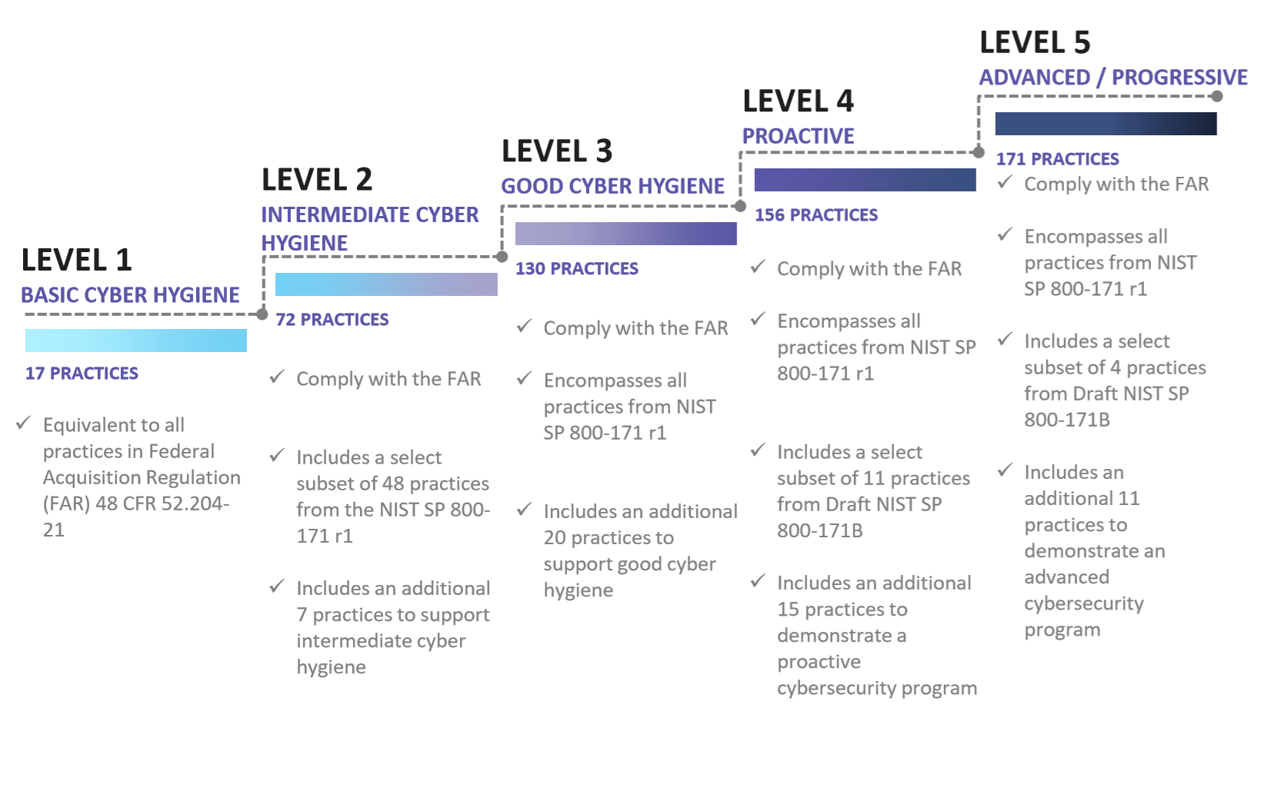
CMMC Practice Progression
https://www.acq.osd.mil/cmmc/docs/CMMC_v1.0_Public_Briefing_20200131_v2.pdf
Microsoft Internal Only
Notes:
Maturity model is meant to span people, process, and technology
Continuous (not a one-time or periodic concern)
Need to integrate this as a core part of doing business with the DoD (and government in general)

Slide 19
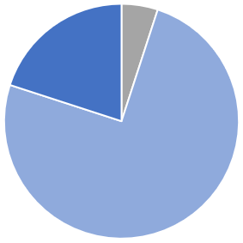
CMMC Level 1 vs. 3
Level 1
Level 3
Level 5
Most DIBs will be level 1
Primarily involves people/process activities
Aligns best to commercial clouds
~50K DIBs will be level 3
Any DIB that handles CUI or is bound by ITAR will be level 3+
Aligns best to government clouds
Market pressure may see DIBs certify to level 3 even if not yet required (prepares them for the future and may provide a competitive edge)
Level 3
Level 1
Levels 4-5 are less defined at this stage so focus is on 1 and 3. Only the most sensitive of scenarios will fall under 4-5.
Microsoft Internal Only
Notes:
Levels 2 and 4 are considered transitional levels. It’s not expected that contracts will require them. They will instead prescribe levels 1, 3, or 5.

Slide 20
Shared Responsibility Model
Customer management of risk
Data Classification and data accountability
Responsibility
On-Prem
IaaS
PaaS
SaaS
Data classification
and accountability
Client & end-point
protection
Shared management of risk
Identity & access management | End Point Devices
Identity & access
management
Application level controls
Provider management of risk
Physical | Networking
Network controls
Host Infrastructure
Physical Security
Customer
Cloud Provider
Microsoft Internal Only
Notes:
Slide guidance: Optional slide if you want to go deeper into the shared responsibility model.
When customers leverage only on-premises IT infrastructure, they have complete responsibility to protect the data and to implement the controls necessary to be compliant with applicable regulatory standards.
Customers using cloud services lessen their burden (sometimes considerably) because the cloud represents a shared responsibility between the customer and the cloud service provider. For example, if you use SaaS like Microsoft 365 or Office 365, Microsoft helps you take care of majority of the controls including physical infrastructure and networking, so customers don’t need to spend resources building their own datacenter or setting up network controls. Work with us and we will begin by guiding you on what matters for your compliance when working with the DoD.
<click to next slide>

Slide 21

CMMC Timeline
CMMC Timelines
2021
2022
2023
2024
2025
2020
Nov 30, 2020
DFARS 7012 interim rule change takes effect
Pathfinder and pilot contracts
Contracts begin including CMMC
All contracts with CMMC
1:Many
1 contract can involve thousands of contractors
Competitive
Potential competitive advantage by certifying sooner
Risk Avoidance
Cost and impact of cybersecurity steadily increasing
Microsoft Internal Only

Slide 22
Summary
CMMC is the DoD’s new cybersecurity requirement
Expected to expand across the Federal government
Even if it’s not always explicitly “CMMC”, cybersecurity maturity is and will continue to grow in importance
It’s not a “checkbox”
Don’t treat this as a formality that once they click the checkbox they can stop worrying about it
Requires re-certification every 3 years
True cybersecurity maturity requires continuous effort
Companies will ideally treat this as a critical aspect of business operations
Any real or perceived “added costs” for meeting CMMC should be thought of as part of the cost of doing business with the government; should accept this and find ways to effectively manage it
Expands beyond NIST 800-171
800-171 has 110 controls
CMMC Level 3 has 130 controls
CMMC Level 4 has 156 controls
CMMC Level 5 has 171 controls
Rolling out over the next 5 years
Pathfinder and pilot contracts in CY21
CY22, new contracts start to include CMMC
All contracts expected to include CMMC by CY25
Should not wait for a contract to include CMMC – be proactive both for CMMC and for cybersecurity maturity in general
Applies to all contractors that want to do business against a DoD contract (as those contracts start to include CMMC)
CMMC has 5 levels of maturity
Most DIBs will be Level 1
DIBs that handle CUI or ITAR data will be at least Level 3
Very small segment of companies will be Level 4 or 5 – reserved for the most sensitive of scenarios
Requirements “flow down” throughout the supply chain
Subs will learn from their Primes what a contract requirements
Partners play a critical role in helping contractors become and stay compliant
Especially smaller DIBs may lack inhouse skills/resources to meet CMMC
More cost-effective to bring in a partner than trying to hire
DoD today – expanding to areas of the federal government
Microsoft Internal Only

Slide 23
Terms
Term | Notes
NIST | National Institute of Standards and Technology. Part of the US Dept of Commerce. Has a broad set of responsibilities. In our case, they authored cybersecurity requirements under NIST SP 800-171.
NIST SP 800-171 | NIST special publication “Protecting Controlled Unclassified Information in Nonfederal Systems and Organizations”. Includes cybersecurity controls that DIBs are expected to meet as part of safely handling sensitive government information. https://csrc.nist.gov/publications/detail/sp/800-171/rev-2/final Typically referred to as “NIST 800-171” or “800-171” depending upon the context of a discussion.
SPRS | Supplier Performance Risk System (https://www.sprs.csd.disa.mil/) DoD system to store assessment scores/information for DIB contractors Recent DFAR 7012 revision requires all DIBs to record scores in SPRS as part of bidding on a contract (they do not need to meet a specific score… just need to have one registered)
DFARS | Defense Federal Acquisition Regulation Supplement The (FAR Federal Acquisition Regulation) is a set of rules for how the US government procures goods. DFARS is a DoD supplement focused on cybersecurity requirements for its contractors.
DFARS 7012 | Safeguarding Covered Defense Information and Cyber Incident Reporting (link) DFARS 252.204-7012, more commonly referred to as DFARS 7012 or “7012”. Specific DFARS clause that describes the core requirements around providing adequate security, cyber incident reporting, and other practices needed to provide comprehensive cybersecurity of defense
DFARS Interim Rule for CMMC | Update to DFARS to implement a DoD assessment methodology and CMMC https://www.federalregister.gov/documents/2020/09/29/2020-21123/defense-federal-acquisition-regulation-supplement-assessing-contractor-implementation-of Effective Nov 30, 2020 Besides formally adopting CMMC, this includes a new requirement for DIBs to register assessment scores in SPRS
Microsoft Internal Only

Slide 24
Terms
Term | Notes
CUI | Controlled Unclassified Information (https://www.dcsa.mil/mc/ctp/cui/, https://www.dodcui.mil/) CUI is government created or owned information that requires safeguarding or dissemination controls consistent with applicable laws, regulations and government wide policies.
FCI | Federal Contract Information: Not intended for public release. It is provided or generated under a government contract to develop or deliver a product or service.
ITAR | International Trade in Arms Regulations. Regulates the export of defense and military related technologies. Information subject to ITAR are held to a higher level of controls than, for example, CUI.
POA&M | Plan of Action & Milestones. A document that describes tasks needed to meet outstanding compliance requirements. It is relatively common for companies to have open items (which is not a good thing). CMMC does not allow for open items – this is a significant change for companies. POA&M is pronounced “poe-am”. As in, Edgar Allen Poe could say, “I am a writer.”
CMMC AB | CMMC Accreditation Body (https://cmmcab.org/). Non-profit, non-government organization contracted by the DoD to implement CMMC via programs to stand up providers, assessors, and trainers.
RPO | Registered Provider Organization. Formal designation awarded by the CMMC AB to organizations that have proven themselves able to provide CMMC advice, consulting, and recommendations. All partners in this campaign are RPOs or are in the process of becoming one.
C3PAO | Certified Third-party Assessor Organization. Formal designation awarded by the CMMC AB to organizations able to conduct CMMC audits.
Microsoft Internal Only
Notes:
Open action items are typically tracked in a POA&M (Plan of Action and Milestones) document.
POA&M is pronounced “poe–am” – as in Edgar Allen Poe and I am hungry
The document describes tasks needed in order to meet outstanding compliance requirements
It is relatively common for companies to have open POA&M items (regardless that they should be closing them in a timely manner)
CMMC does not allow for open items – i.e., companies will likely need to take on work that they may have been holding off for a while due to complexity/costs

Slide 25
Campaign Execution
Microsoft Internal Only

Slide 26




Campaign Goals & KPIs
Lead to Opportunity Ratio : 13.6%*
Opportunity to Revenue Ratio : 60.4%
Objective
DIB customers choose the Microsoft Cloud on their journey to CMMC compliance
Key Result
At least 2500 DIB companies are generating avg 5K ACR per month in Azure Government (CY21)
Customer Adds : 233 Azure; 83 MW & S
Azure : $7.7m; MW&S : $4.8m
* Based upon previous campaigns – hypothesis is higher lead to opportunity ratio in this campaign given CMMC as a compelling event

Slide 27
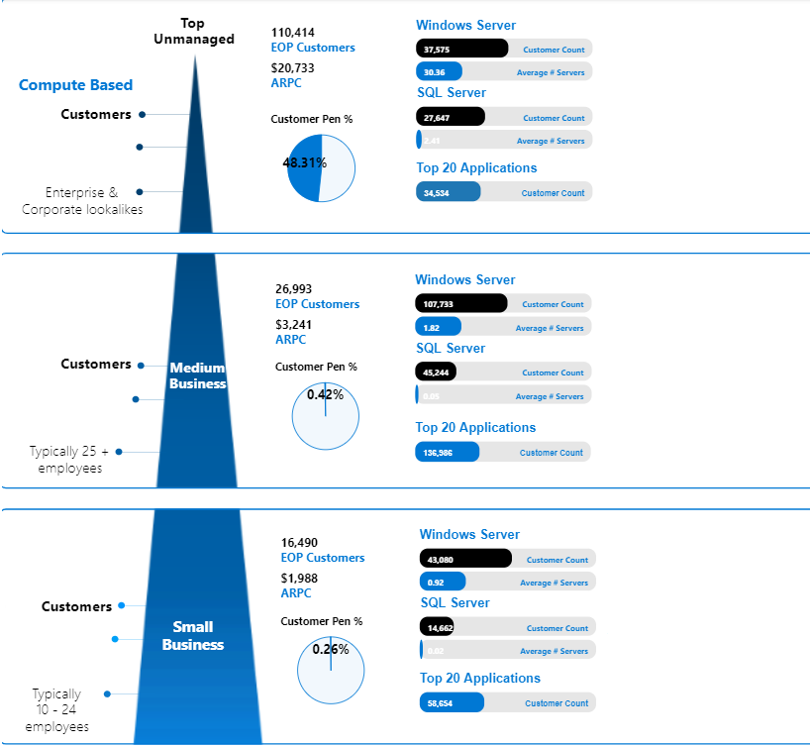


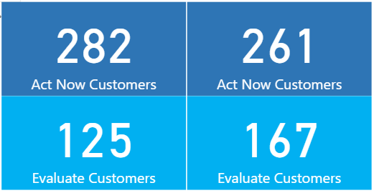
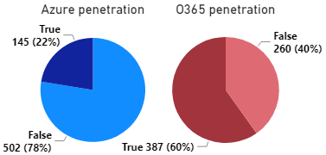
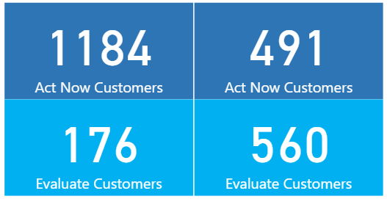
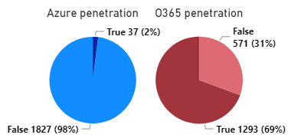
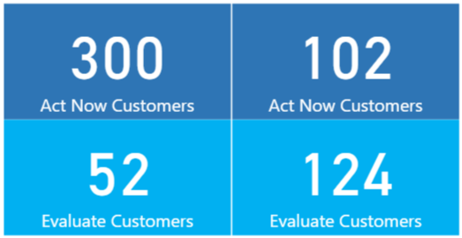
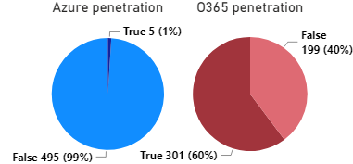
Who’s in the Campaign
647
Prime and sub awardees to DoD contracts in FY20
Publicly US gov spending data (http://usaspending.gov/)
Matched against MS sales systems
From ~11K to 9,336
Removed any that are managed, on do not contact list, or already engaged
1,864 +
6,607
500
Microsoft Internal Only
Notes:
Identified target DIBs via publicly accessible US government spending data
https://www.usaspending.gov/
Identified prime and sub contractor awardees in FY20 as of mid-Jan 2021
11,184 awardees
Matched against MS sales data to identify
Any managed accounts, already in a sales motion, or part of no-contact list were removed
9,336 remained available to contact
Of the 9,336:
2,729 matched as unmanaged SMBs
Higher confidence
Able to identify incumbent partners
6,607 un-matched = not in MS sales however could be a broader type of customer

Slide 28
Customer Concerns
CMMC Timelines
Costly
The DoD believes CMMC “will not be [cost] prohibitive”, especially because companies are supposed to already be meeting NIST 800-171
A CMMC audit is an “allowable cost” which means it can be reimbursed
Industry expectations believes this may be more costly than DoD estimates – especially because many organizations are at a lower maturity level
Complex
What to do, how to achieve it, and how to maintain it can be a lot for an organization to figure out, especially when they don’t have dedicated compliance/security teams
CMMC partners are key to helping them through this
Added Overhead
Need to be re-certified every 3 years
Companies should treat this as a continuous effort regardless of the periodic audit
MSPs and MSSPs are positioned to mitigate this
Undefined
CMMC is still in its early stages where certain requirements are expected to change/evolve
The pathfinder and pilot contracts this CY will help vet what’s working/what needs tweaking
Unfamiliar with CMMC
Primes should be communicating to their Subs but it is likely that many DIBs aren’t fully aware/familiar with CMMC
If a customer pushes back that they don’t do business with the DoD:
We identified their organization as having been a prime or sub of a DoD award (maybe they don’t plan to continue this business but more likely the person you’re speaking with is unfamiliar with this)
Most of our CMMC partners are able to conduct a pre-assessment to confirm to what degree CMMC applies to them
Microsoft Internal Only

Slide 29
The Right Contact
Large
Medium
Small
Decision makers – find the person that can make a decision that affects the entire company and the way it operates
They should also be able to appreciate the business implications given CMMC is not optional – if they want to keep this line of business they need to take action
Security/Compliance – the above person should also be familiar with security and/or compliance
Smaller companies (<100 employees): Founder, CEO
Companies with dedicated security/compliance organizations: CIO, CISO
Microsoft Internal Only

Slide 30
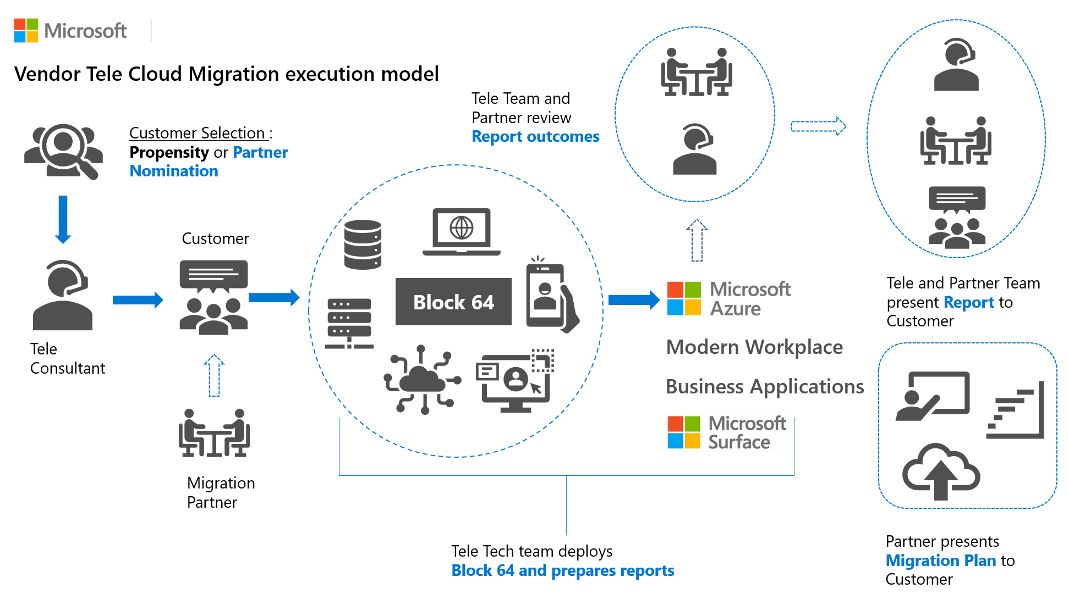
SMB Cloud & Security Vulnerability Evaluations

Slide 31





Standard MS talking points apply
Spans Commercial and Government Clouds
No other CSP has this level of 1st party capabilities
The Microsoft Cloud
Productivity
Email, File Sharing, Collaboration
Infrastructure
IaaS, PaaS
Security Suite
SEIM, Endpoint Protection
Relationship Management
Customer Relationship Management
DevOps
Source Control, Deployment Pipelines
Microsoft is the Most Complete Cloud Solution
Microsoft Internal Only

Slide 32
CMMC Acceleration Program Strategy
Easy Button = Microsoft Cloud
Managed Service Providers
One-Microsoft Initiative
Inherit controls by adopting Azure, M365, D365 & GitHub
Complete cloud solution (IaaS/PaaS/SaaS) w/ Microsoft security suite
Reference architectures and blueprints
Customer documentation for CMMC assessments
Scale play to thousands of small DIB companies
Provide Mission Enclaves for large DIB Tier 1 Primes
Host/manage on behalf using the Microsoft cloud
Marketplace & other channels to showcase partners
Office building CMMC documentation for M365 and GCC High
Sentinel building SEIM workbooks for CMMC
Microsoft Federal deploying AM95
CELA mapping controls
MCS delivering offers
Microsoft Internal Only
Notes:
Easy Button = Microsoft Cloud
Reciprocity where adoption of Azure and M365 includes inherited controls
Certified by C3PAO’s
Microsoft is a complete cloud solution
IaaS, PaaS, SaaS
No need to cobble together disparate solutions
Comprehensive reference architectures and blueprints
Managed Service Providers
Scale play by arming/enabling partners to go after the thousands of small DIB companies that can’t do this on their own
DIBs with ten’s of employees or generally <500 employees
Don’t have dedicated IT/cybersecurity staff
May have limited cloud presence
Great candidates for a partner to modernize their companies by moving to the Microsoft cloud
Host/managed on behalf of the small DIBs using the Microsoft cloud
Win-win… we showcase partners via the marketplace, https://aka.ms/azuregovdocs, etc.
Potentially enable a Compliance or Cybersecurity-like partner specialization
What we are NOT focusing on
While there may be a very small number of strategic plays with large partners, this program is not focused on that segment
These customers are generally self-sufficient that can do this in-house or have existing partner relationships
Our limited Azure Global staffing cannot scale to meet the high-touch needs of these customers
Instead, we’ll apply our above strategy which focuses on the smaller DIBs

Slide 33
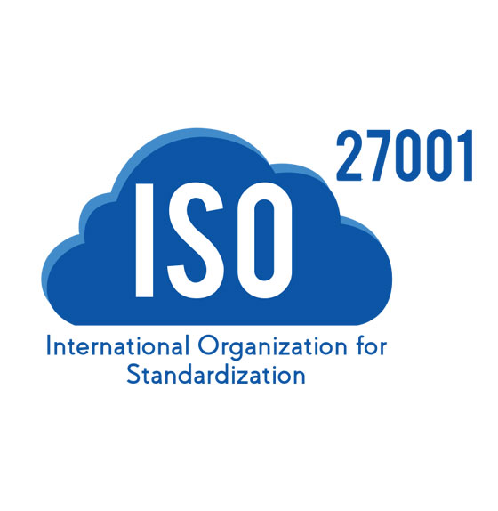
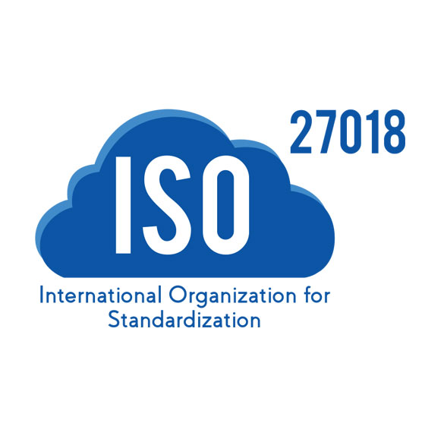
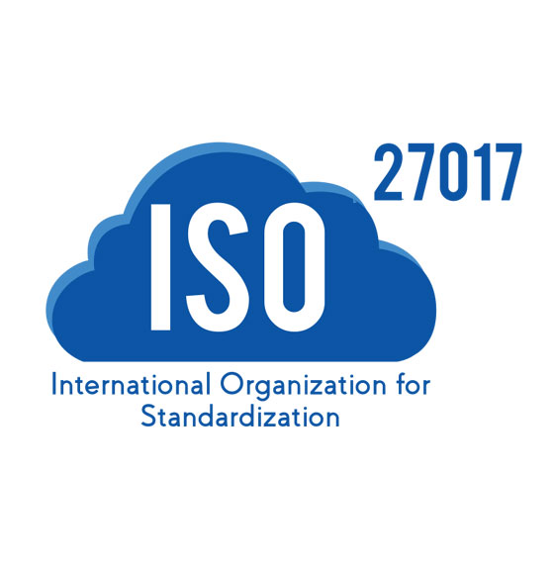
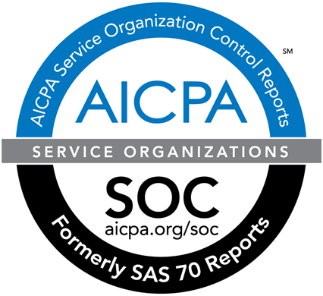
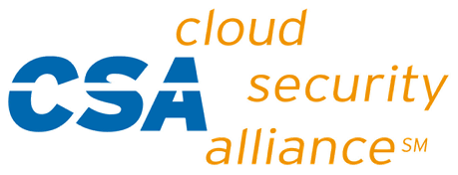
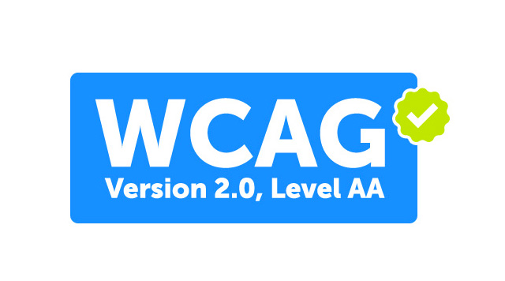

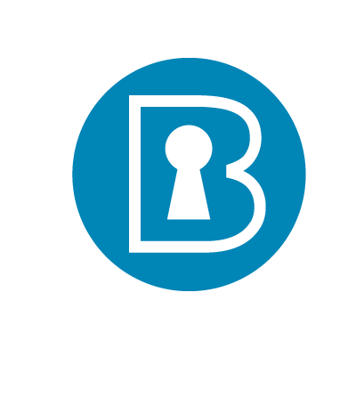
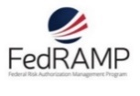

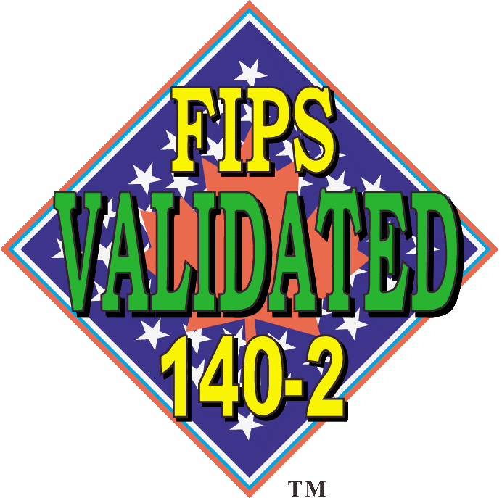






















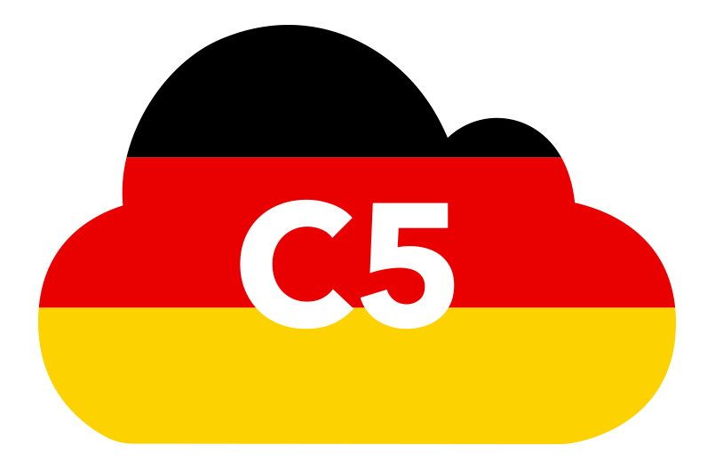






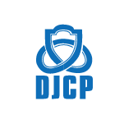





Microsoft has one of the largest compliance portfolios in the industry
GLOBAL
SOC 1
Type 2
SOC 2
Type 2
CSA STAR
Self-Assessment
CSA CCM
WCAG 2.0
AA
ISO 20000-1¹
CIS Benchmark
ISO 27001
ISO 27018
ISO 27017
US GOV
We do a lot, but we do not “make you compliant”
FedRAMP High
DoD DISA
SRG Level 2²
DoD DISA
SRG Level 4²
DoD DISA
SRG Level 5²
SP 800-171² SP 800-53
FIPS 140-2
Section 508
ITAR²
CJIS²
IRS 1075²
DFARS²
CMMC²
INDUSTRY
Japan
FISC
HIPAA / HITECH Act
HITRUST
Self-assessment
GxP
21 CFR Part 11
Netherlands
NEN 7510
GLBA
FFIEC
FERPA
REGIONAL
Argentina PDPA
Australia
IRAP/CCSL
EU
Model Clauses
EU
GDPR
EU EN
301 549
EU
ENISA IAF
EU-US
Privacy
Shield
UK
G-Cloud
Germany
IDW PS 951
Germany
C5³
Germany IT
Grundschutz
workbook³
Canada
Privacy Laws
Netherlands
BIR 2012
Spain
ENS
New Zealand
GCIO
Singapore
MTCS
China
DJCP¹
China
GB 18030¹
China
TRUCS¹
Japan My Number Act
Japan CS Mark Gold
1 Only for Office 365 operated by 21 Vianet | 2 Applies to US Govt. GCC, GCC High, or DoD clouds | 3 Only for Office 365 Germany
Microsoft Internal Only
Notes:
Suggested Script: To help all types of organizations adhere to global, regional, and industry-specific requirements governing controlled data, Microsoft offers the most comprehensive set of certifications and attestations of any cloud service provider.
Our strong and continuous commitment to delivering services that comply with these US regulatory and security requirements is core to Microsoft’s sovereign cloud offering. With this commitment, your organization can trust that Microsoft’s cloud and our technology tools will help you manage your compliance obligations in an ever-changing landscape of regulations and standards.
Each one of these compliance standards represents hundreds or thousands of security and compliance requirements and controls that you may be required to meet. These requirements are complicated and sifting through all this is overwhelming for most organizations.
But instead of you taking on the full burden to keep up with all these requirements, Microsoft does most of the work for you through our investments in obtaining these certifications and taking our cloud platform and capabilities through third-party audits and regulatory approvals.
<click to next slide>

Slide 34
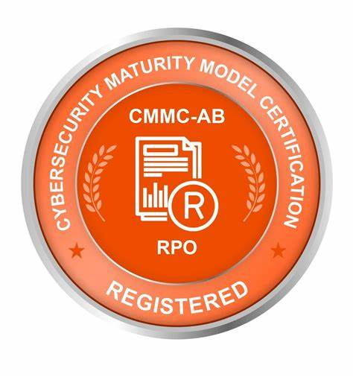
Partner Strategy
Proven
CMMC Registered Provider Organizations (RPOs)
Multi-Partner
May be combination of incumbent + RPOs + resellers
Microsoft Internal Only
Notes:
We can’t easily leverage just any partner for this campaign
Need partners that:
Familiar with working in the defense space, especially the regulations they and their customers need to meet
Specifically familiar with CMMC to drive the right activities in that space
Our CMMC partners are CMMC Registered Provider Organizations (RPO), or in the process of becoming one – RPO is a formal designation that implies reasonable competence in providing CMMC services
In many cases, we will see multiple partners through the course of a CMMC engagement
Incumbent partners may continue to provide whatever services they have been
Resellers, especially AOSG for M365, to provide licensing
CMMC-qualified partners to help with assessments, addressing remediation items
Manage service providers to provide ongoing/continuous compliance

Slide 35
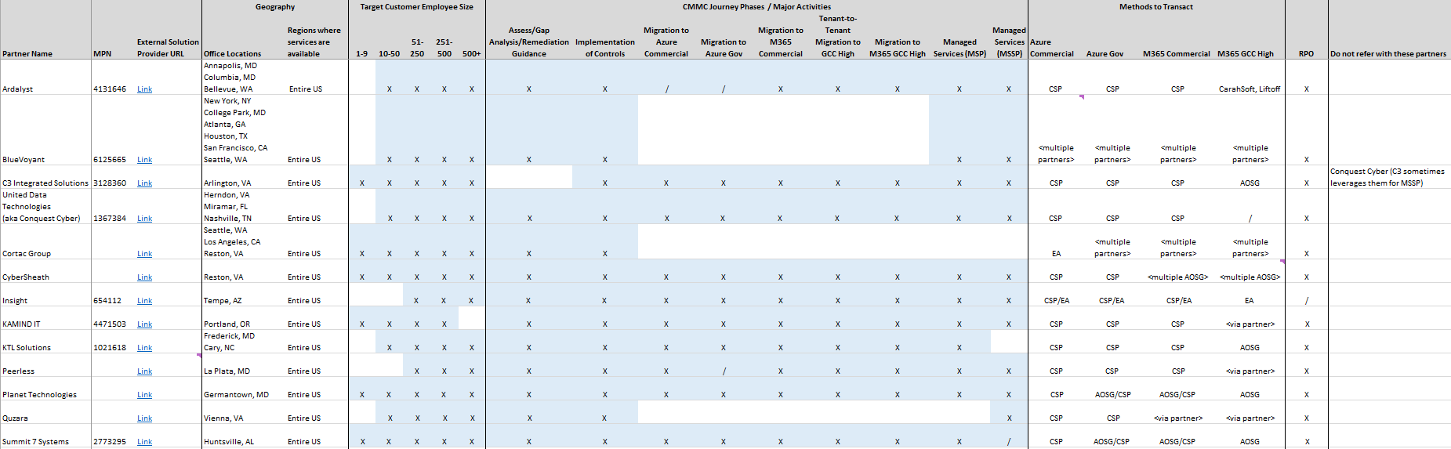
Campaign Partners
Microsoft Internal Only
Notes:
Can expect multiple partners to play a role in helping a customer through their CMMC journey
Not all partners can do “everything”
In fact, partners that claim they can do everything may not have the depth in every aspect as partners that choose to focus in certain areas
Managed service providers (and potentially other partners) need to be CMMC compliant, too
Any partner that has exposure to FCI/CUI will need to meet CMMC compliance requirements just like the DIBs

Slide 36
High-Level Partner Engagement Scenarios
Do it all for me
Get me to where I need to be then I’ll take over
Show me what to do and I’ll take care of it
Especially smaller organizations that don’t have the skills/resources in-house
Looking for an MSP and/or MSSP
Accelerate compliance via partners getting them to a desired end state
Able to manage/maintain the environment on their own
Want guidance on what to do but may be able to do all or most activities
In-house skills for compliance, security, and the cloud

Slide 37


* Partners at campaign launch. Additional partners available to expand the campaign or other CMMC Acceleration Program activities.
CMMC Acceleration Program Partners*
Ardalyst
BlueVoyant
C3 Integrated Solutions
Conquest Cyber
Cortac Group
CyberSheath
Insight
KAMIND IT
KTL Solutions
Peerless
Planet Technologies
Quzara
Summit 7 Systems
Proven
CMMC AB Marketplace Registered Provider Organizations (RPOs)
Partner Network
Certified in the Microsoft Partner Network
Microsoft Internal Only

Slide 38
Summary
Leverage the compelling event that CMMC brings to 350K companies
Primarily target unmanaged DIBs – majority we assume are small/medium
Find the right decision maker – this can touch an entire company’s operations
Connect DIBs with our vetted list of Microsoft partners
Partners are established in the DIB and qualified to provide CMMC services
Microsoft uniquely positioned as a CSP with 1st party productivity, infrastructure, and security services
The DoD and many DIBs already use the Microsoft cloud, especially our government clouds
Do not overstate Microsoft’s role in a company meeting compliance requirements
Using Microsoft does not “make you compliant”
Microsoft Internal Only

Slide 39
Session 2 Technical Readiness

Slide 40
Agenda for Session 2
Questions / follow-up from session 1
Common scenarios
Commercial vs. Government Clouds
Microsoft Security and Compliance Resources for CMMC

Slide 41
Compliance & Government Clouds

Slide 42
The Big Questions
Commercial
Government
?
Do I host my entire organization there or split it up?
Which cloud do I need to use?

Slide 43

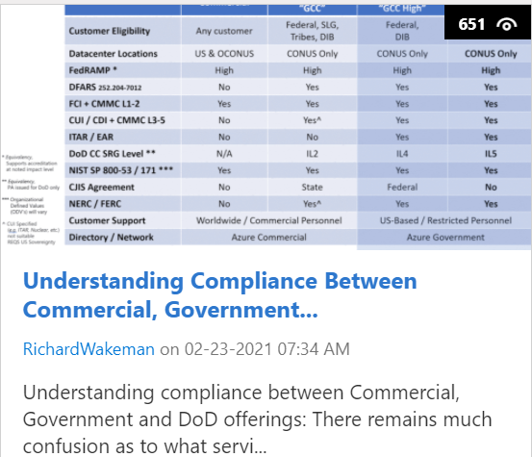
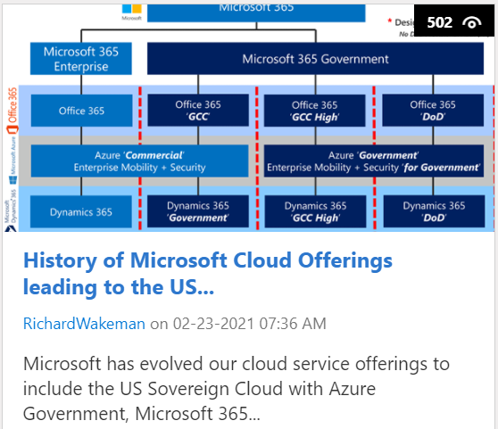
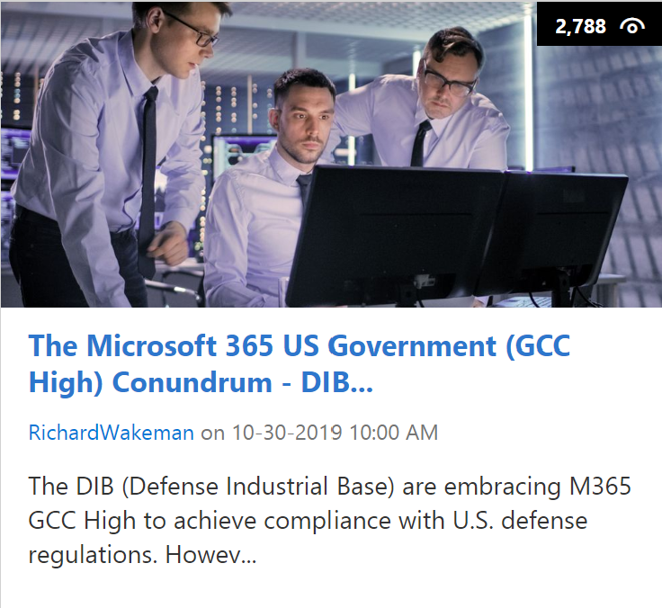
Public Sector Community Blog
History of Microsoft Cloud Service Offerings leading to the US
The Microsoft 365 US Government (GCC High) Conundrum - DIB Data Enclave vs Going All In
Understanding Compliance Between Microsoft 365 Commercial, Government and DoD Offerings
Notes:
Historically, organizations that had to meet government requirements had limited cloud options and were “stuck” on-prem. They would stand-up purpose-built environments for their government business.
Now, we have Azure Government, GCC and GCC High, etc.

Slide 44

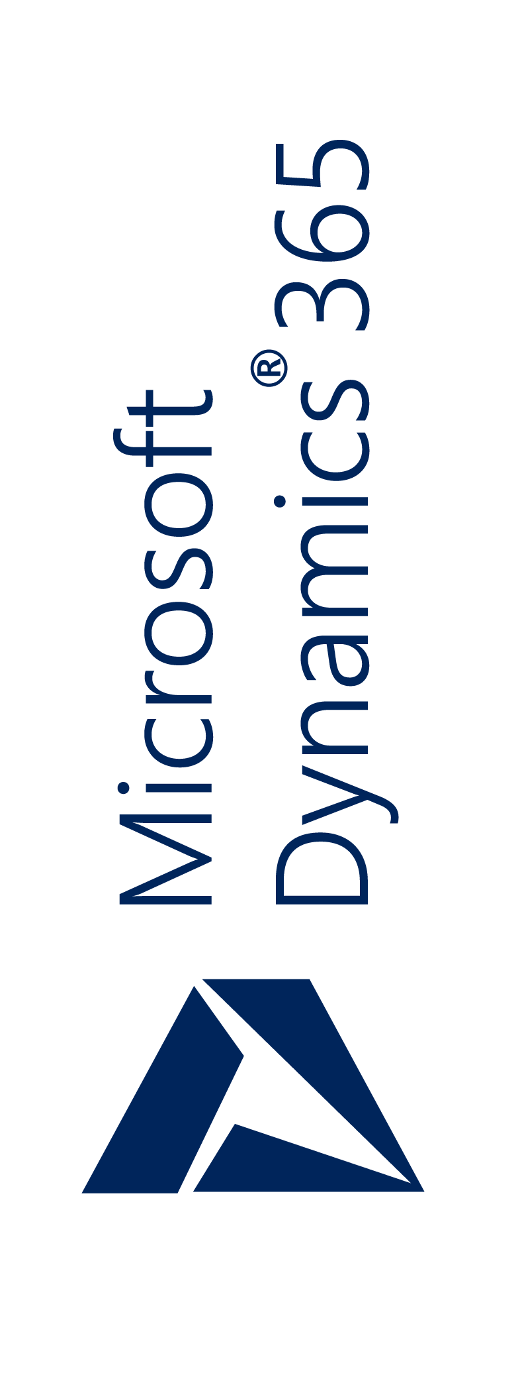
History of Microsoft Cloud Service Offerings leading to the US
Microsoft 365
* Designates Equivalency No DoD Provisional Auth (PA)
Microsoft 365 Enterprise
Microsoft 365 Government
Office 365
Office 365
‘GCC’
Office 365
‘GCC High’
Office 365
‘DoD’
Azure ‘Commercial’
Enterprise Mobility + Security
Azure ‘Government’
Enterprise Mobility + Security ‘for Government’
“Secret” DISA SRG Impact Level 6
Dynamics 365
Dynamics 365 ‘Government’
Dynamics 365
‘GCC High’
Dynamics 365
‘DoD’
Commercial
DISA SRG Impact Level 2*
DISA SRG Impact Level 4*
DISA SRG Impact Level 5

Slide 45
History of Microsoft Cloud Service Offerings leading to the US
Microsoft 365
* Designates Equivalency No DoD Provisional Auth (PA)
Microsoft 365 Government
Microsoft 365 Enterprise
Microsoft 365 Government
Office 365
Office 365
‘GCC’
Office 365
‘GCC High’
Office 365
‘DoD’
Azure ‘Commercial’
Enterprise Mobility + Security
Azure ‘Government’
Enterprise Mobility + Security ‘for Government’
“Secret” DISA SRG Impact Level 6
Dynamics 365
Dynamics 365 ‘Government’
Dynamics 365
‘GCC High’
Dynamics 365
‘GCC High’
Commercial
DISA SRG Impact Level 2*
DISA SRG Impact Level 4*
DISA SRG Impact Level 5

Slide 46
Cloud Decision Tree
This is a simplified decision tree that should be useful for most small/medium-sized DIBs
Ultimately, this DIBs should work with their CMMC partners to have a thorough review and determine what best fits their scenario
Level 1 or 3 ?
CMMC Level 3
CUI and/or ITAR
ITAR?
CUI + ITAR
GCC High + Azure Government
CMMC Level 1
No CUI or ITAR data handling
No ITAR (CUI Basic only)
Any MS Cloud
Normally Commercial cloud although Government clouds can also be used
GCC + Azure Commercial
Microsoft Internal Only

Slide 47
Microsoft Azure, a strong foundation
Azure Government
Physically separated instance of Microsoft Azure
The only hyper-scale cloud built specifically for U.S. government
Meets the most complex compliance standards
Designed to exceed U.S. government requirements
Supports the broadest selection of services, tools, and languages
Microsoft Azure
Productive
Hybrid
Intelligent
Trusted
Notes:
Our Government customers asked for all the robust features and services of Azure Public, while providing a number of features specific to securing government data. To that end, we designed the Azure Government.
Azure GOV is a dedicated government-community cloud that extends the world-class security and control of Azure for Government customers. Only US federal, State, local and tribal governments and their partners have access to this dedicated instance that is operated by screened US citizens.
Hybrid flexibility: Customers can choose to maintain some data and functionality on-premises and control the timing and implementation of digital transformation.

Slide 48
Azure Government, mission ready
Advanced infrastructure,
8 Gov regions (2 at IL5), 2 Secret, 8 ExpressRoute sites
Seattle ExpressRoute
US Gov Iowa
New York ExpressRoute
Chicago ExpressRoute
Sole government-only offering to span IaaS, PaaS and SaaS
Silicon Valley
ExpressRoute, CAP
US DoD East
US Gov Arizona
Washington D.C. ExpressRoute, CAP
US DoD Central
91 compliance regimes, broadest and most comprehensive in the industry
US Gov Texas
Phoenix
ExpressRoute
US Gov Virginia
Dallas
ExpressRoute, CAP
Customers in every Federal cabinet level agency
San Antonio
ExpressRoute
Customers in DoD – Army, Navy, Air Force, and the Marine Corps
Notes:
Microsoft is announcing several important advances. We are adding two more regions to the Azure Government region count, bringing the number of dedicated regions to a total of eight. As announced last fall, these regions will be enabled for data classified Secret and provide commercial-grade hyperscale cloud services with the highest availability, deepest compliance, and fastest innovation available to support the most critical of U.S. Government missions.
Government customers can take advantage of growing connectivity options with two new ExpressRoute sites coming soon at San Antonio and Phoenix, providing choice and convenience when connecting between on-premises and virtual resources in the cloud and enabling reliable connection for scenarios like data migration, disaster recovery or other high-availability needs. We have added key networking services such as VNet service endpoints for storage and SQL and Network Watcher for more secure building of applications and monitoring.

Slide 49





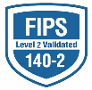



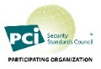
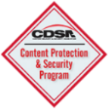
























The most trusted and compliant cloud
GLOBAL
ISO 27001
ISO 27018
ISO 27017
ISO 22301
ISO 9001
SOC 1
Type 2
SOC 2
Type 2
SOC 3
CSA STAR
Self-Assessment
CSA STAR
Certification
CSA STAR
Attestation
US GOV
Moderate
JAB P-ATO
High
JAB P-ATO
DoD DISA
SRG Level 2
DoD DISA
SRG Level 4
DoD DISA
SRG Level 5
SP 800-171
FIPS 140-2
Section 508 VPAT
ITAR
CJIS
IRS 1075
INDUSTRY
PCI DSS
Level 1
CDSA
MPAA
FACT
UK
Shared
Assessments
FISC
Japan
HIPAA/ HITECH Act
HITRUST
GxP
21 CFR Part 11
MARS-E
IG Toolkit
UK
FERPA
GLBA
FFIEC
REGIONAL
Argentina PDPA
EU
Model Clauses
UK
G-Cloud
China
DJCP
China
GB 18030
China
TRUCS
Singapore
MTCS
Australia
IRAP/CCSL
New
Zealand
GCIO
Japan My
Number Act
ENISA
IAF
Japan CS Mark Gold
Spain
ENS
Spain
DPA
India
MeitY
Canada
Privacy Laws
Privacy
Shield
Germany IT
Grundschutz
workbook
Trust Center

Slide 50
Shared responsibility model
Customer management of risk
Data Classification and data accountability
Responsibility
On-Prem
IaaS
PaaS
SaaS
Data classification
and accountability
Client & end-point
protection
Shared management of risk
Identity & access management | End Point Devices
Identity & access
management
Application level controls
Provider management of risk
Physical | Networking
Network controls
Host Infrastructure
Physical Security
Customer
Cloud Provider
Notes:
Slide guidance: Optional slide if you want to go deeper into the shared responsibility model.
When customers leverage only on-premises IT infrastructure, they have complete responsibility to protect the data and to implement the controls necessary to be compliant with applicable regulatory standards.
Customers using cloud services lessen their burden (sometimes considerably) because the cloud represents a shared responsibility between the customer and the cloud service provider. For example, if you use SaaS like Microsoft 365 or Office 365, Microsoft helps you take care of majority of the controls including physical infrastructure and networking, so customers don’t need to spend resources building their own datacenter or setting up network controls. Work with us and we will begin by guiding you on what matters for your compliance when working with the DoD.
<click to next slide>

Slide 51
Shared responsibility examples
Microsoft partners with you to meet your security, compliance, and privacy needs
Access to production environment
Access to production environment
Set up access controls that strictly restrict standing access to customer’s data or production environment
Set up access control policy and SOP, leveraging Customer Lockbox*/ identity management solutions
Protect data
Microsoft’s responsibility
Organization’s responsibility
Protect data
Encrypt data at rest and in transit based on industrial standards (BitLocker, TLS, etc.)
Encrypt data based on org’s compliance obligations. E.g. encrypt PII in transit between users, using its own encryption key, etc.
Personnel control
Personnel control
Strict screening for employees, vendors, and contractors, and conduct trainings through onboarding process
Allocate and staff sufficient resources to implement and operate an organization-wide privacy program, including awareness-raising and training
*Customer Lockbox is coming soon to GCC High
Notes:
We _enable_ compliance rather than _provide_ compliance
We provide _capabilities_ and customers use them to implement _practices_ (in CMMC language)
Achieving a control _objective_ can be vastly more effective than satisfying a control _requirement_
Slide guidance: more information on the shared responsibility model.
Suggested Script:
Compliance in the cloud is not just a check of the box. As your cloud service provider, Microsoft partners with your organization to meet your security, compliance, and privacy needs under a shared responsibility model.
It’s important to note: When data resides on-premises (meaning your own datacenters), you are 100% responsible to meet all regulatory requirements. When you move to Microsoft’s Cloud, Microsoft implements and manages the larger part of the platform controls.
For example, we’ve built over 1,000 controls in our Office 365 control framework that enable us to stay up to date with ever-evolving industry standards and regulatory requirements in the numerous compliance certifications that Microsoft 365 meets. But compliance in the Microsoft cloud is also a shared responsibility between Microsoft and its customers. We work to ensure that we meet industry and international standards, and our customers are responsible for ensuring they have the correct processes in place to protect data within the Microsoft Cloud in a manner that helps them meet compliance requirements.
We not only provide continuous compliance on our end, but we also provide transparency, tools, and recommendations to help our customers manage continuous compliance on their end. Further, we engage deeply with regulators to educate them about our cloud services and get their feedback, so we can improve our services accordingly and continuously.
<click to next slide>
*Disclaimer: Customer Lockbox is coming soon to GCC High. Check the roadmap on OnRamp for the latest information on availability: Internal source: https://microsoft.sharepoint.com/sites/Infopedia_G03/officeonramp/SitePages/Office365USGov.aspx#Apps

Slide 52
Service Offering Differentiation
 | Commercial | M365 “GCC” | M365 “GCC High” | M365 “DoD”
Customer Eligibility | Any customer | Federal, SLG, Tribes, DIB | Federal, DIB | DoD only
Datacenter Locations | US & OCONUS | CONUS Only | CONUS Only | CONUS Only
FedRAMP * | High | High | High | High
DFARS 252.204-7012 | No | Yes | Yes | Yes
FCI + CMMC L1-2 | Yes | Yes | Yes | Yes
CUI / CDI + CMMC L3-5 | No | Yes^ | Yes | Yes
ITAR / EAR | No | No | Yes | Yes
DoD CC SRG Level ** | N/A | IL2 | IL4 | IL5
NIST SP 800-53 / 171 *** | Yes | Yes | Yes | Yes
CJIS Agreement | No | State | Federal | No
NERC / FERC | No | Yes^ | Yes | Yes
Customer Support | Worldwide / Commercial Personnel |  | US-Based / Restricted Personnel
Directory / Network | Azure Commercial |  | Azure Government
* Equivalency, Supports accreditation at noted impact level ** Equivalency, PA issued for DoD only *** Organizational Defined Values (ODV’s) will vary ^ CUI Specified (e.g. ITAR, Nuclear, etc.) not suitable REQS US Sovereignty
US Sovereign Cloud
Public Sector Blog

Slide 53
Data Enclave vs Going All-In

Slide 54


Shared Data vs Personal Data
Shared Data Examples
Unstructured File Storage on a File Share
SharePoint Team Site Document Library
Teams Group Files or Shared Calendar
Exchange Shared Mailbox or Public Folder
Published application (e.g. ERP, DevOps)
Personal Data Examples
Personal in the Enterprise Context…
My Documents
OneDrive for Business
Exchange Personal Mailbox
Teams or Skype for Business SIP Account

Slide 55
Public Sector Community Blog
The Microsoft 365 US Government (GCC High) Conundrum DIB Data Enclave vs Going All In
Data Enclave
All In
MIGRATE

Slide 56
Going All-In
Everyone is within the same (highest) compliance boundary
Reduced risk for spillage
Single tenant always better user experience than bifurcated tenant
Microsoft engineers for a single customer in 1 tenant
Consolidated device registrations
Consistent conditional access policies
Simplified CMMC Certification

Slide 57
Microsoft CMMC Strategy for Products
Blogs
Microsoft CMMC Acceleration Program Update – January 2021 by Richard Wakeman
Accelerating CMMC compliance for Microsoft cloud (in depth review) by Richard Wakeman
CMMC with Microsoft Azure: Access Control (1 of 10) by TJ Banasik
Certifying with the Microsoft Cloud, how Microsoft products meet CMMC
*Focus on products, not the enterprise*
Allowable reciprocity for NIST SP 800-53 / FedRAMP
Allowable reciprocity for DoD CC SRG Impact Level 4 in Government clouds
Demonstrate compliance with DFARS 252.204-7012 in Government clouds
Demonstrate adoption of NIST Cybersecurity Framework (CSF)
Intend to include all Microsoft Cloud offerings

Slide 58
CMMC Acceleration Program
First release in Q4 CY20
Targeting CMMC Level 3
Recommend Azure Government + M365 GCC High *Not Required
Pre-configured for cloud-native environments
Pre-configured environment
Fully hosted environments – Primarily SMB
DIB cloud shared enclaves – Aligned to Mission or Prime supply chain
Segmented environments – Isolated business units
Scaffolding for partners to build managed solutions on

Slide 59
CMMC Acceleration Program Update - January 2021
Reciprocity & Inheritance
Microsoft Product Placemat for CMMC
Azure Sentinel: CMMC Workbook
STIG Automation
Compliance Manager CMMC Levels 1-5 Assessment Templates
Azure Blueprint for CMMC Level 3
Azure Security Benchmark Foundation
Microsoft Cybersecurity Reference Architecture
More to come!

Slide 60
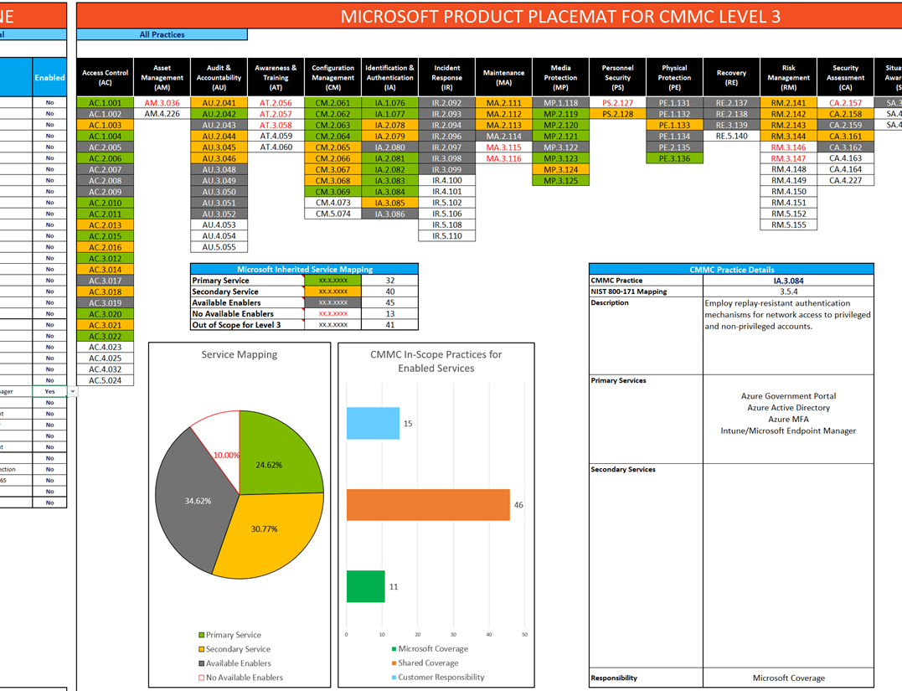
Microsoft Product Placemat for CMMC
Illustrates CMMC Practices with Microsoft product coverage
Interactive with drill down of implementation statements
Select based on SKU (E5, E3, etc)
M365 E5 covers 18 practices outright and 74 have Shared Coverage
Shared Coverage means that the customer is required to implement and configure the practice to the standard for your tenant

Slide 61
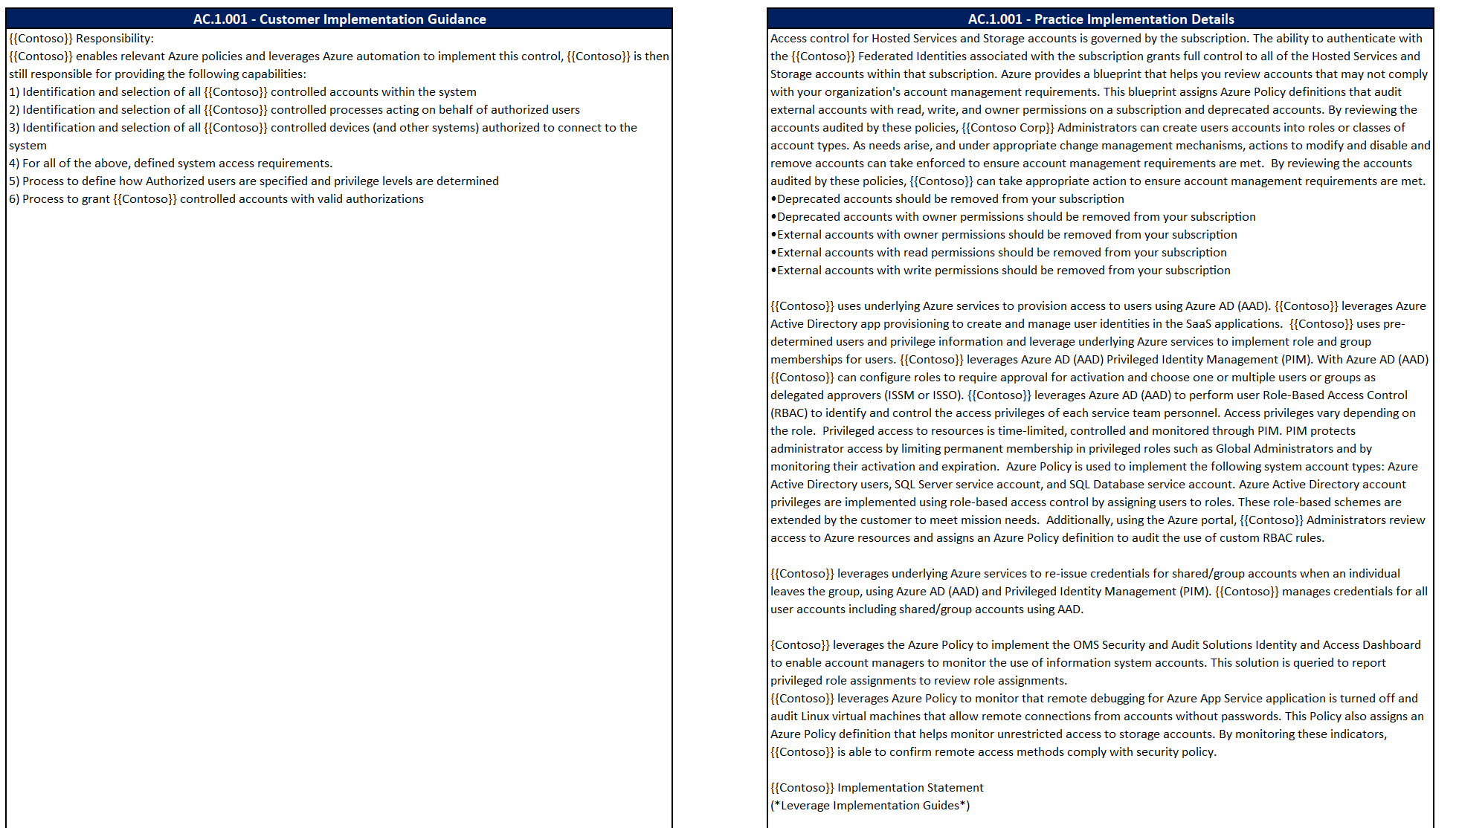
Product Placemat Implementation Guidance
Drill down on specific practices for general implementation guidance
Download Today!
https://aka.ms/cmmc/productplacemat

Slide 62
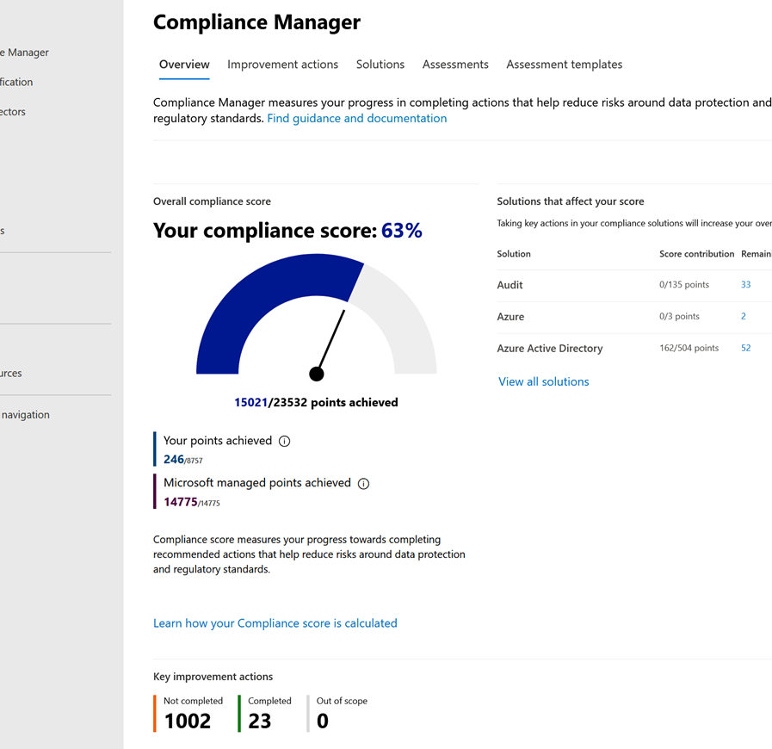
Microsoft Compliance Manager
Microsoft Compliance Manager is a feature in the Microsoft 365 Compliance Center
Assessment Templates include NIST SP 800-171 and CMMC Levels 1-5
Available in Microsoft 365 Commercial, Government (GCC & GCC High)
* Automated Testing not available in GCC High

Slide 63
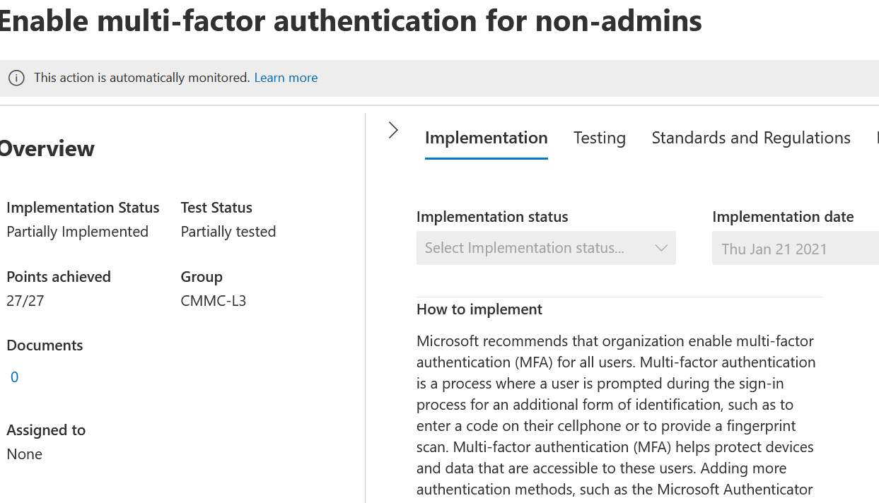
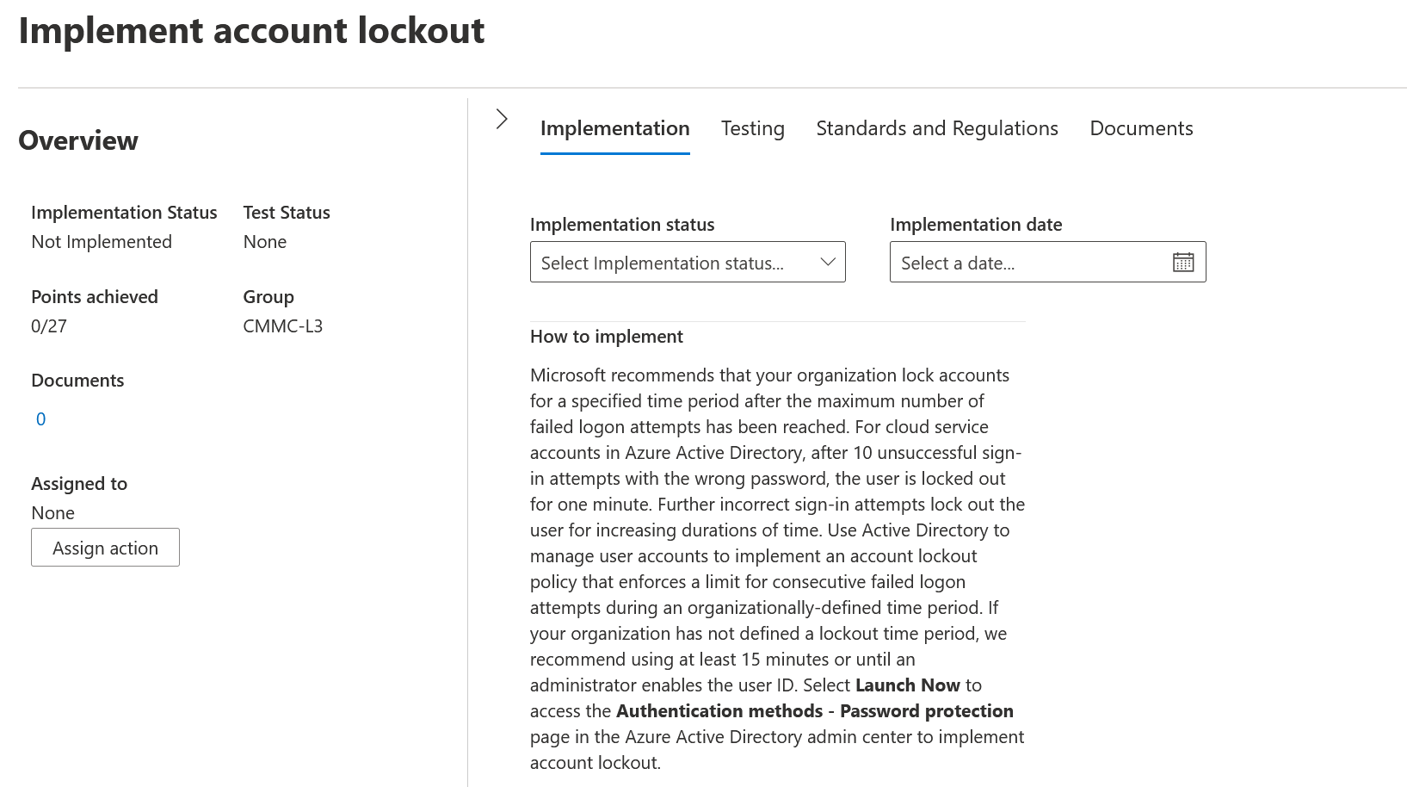
Microsoft Compliance Manager Improvement Actions
Suggests actions to meet intent of each CMMC Practice requirements
Links to reference documentation and how-to support articles
Improves Compliance Score as actions are implemented *Compliance Score not associated with NIST SP 800-171A nor with SPRS
Allows for assignment to individuals
Allows for uploading of documentation

Slide 64
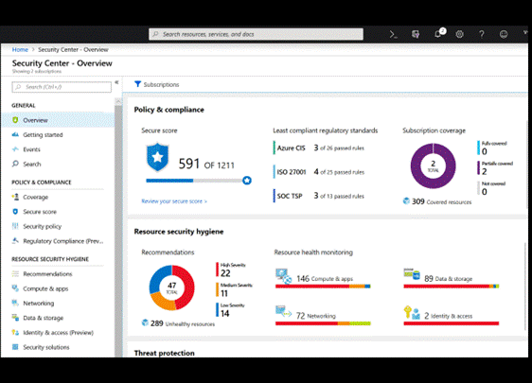
Azure Security Center
Azure Security Center is integrated with Azure Defender
Azure Blueprints include samples for NIST SP 800-171 and projected requirements for CMMC Levels 3
CMMC Level 3 Azure Blueprint sample public preview available now

Slide 65

Azure Security Benchmark Blueprint
To help organizations stay secure in a
zero trust environment
Azure Security Benchmark Foundation
is a Blueprint that providing a set of baseline infrastructure patterns to assist in building a
secure and compliant Azure environment

Slide 66

Microsoft Cybersecurity Reference Architecture
https://aka.ms/mcra

Slide 67

Introducing Microsoft Azure Sentinel
Cloud-native SIEM for intelligent security analytics for your entire enterprise
Collect
Limitless cloud speed and scale
Security data across your enterprise
Bring your Office 365 data for Free
Respond
Detect
Easy integration with your existing tools
Rapidly and automate protection
Azure Sentinel
Threats with vast threat intelligence and AI
Cloud-native SIEM+SOAR
Faster threat protection with AI by your side
Investigate
Critical incidents guided by AI
Notes:
That’s why we re-imagined the SIEM + SOAR tool to introduce a new cloud-native solution called Microsoft Azure Sentinel - providing intelligent security analytics at cloud scale for your entire enterprise.
Azure Sentinel makes it easy to collect security data across your entire hybrid organization from devices, users, apps, servers and any cloud, it uses the power of artificial intelligence to ensure you are identifying real threats quickly, and unleashes you from the burden of traditional SIEMs by eliminating the need to spend time on setting up, maintaining and scaling infrastructure.
Since it is built on Azure, it offers limitless cloud scale and speed, scaling automatically to address your needs.
Traditional SIEMs have also proven to be expensive to own and operate, often requiring you to commit upfront and incur high cost for infrastructure maintenance and data ingestion. With Azure Sentinel there will be no upfront costs, you will only pay for what you use, and we are offering free Office 365 activity data import to help you reduce security costs significantly

Slide 68
Summary
In general, CMMC level 1 aligns to our commercial clouds whereas level 3 aligns to our government clouds (primarily Azure Gov and O365 GCC High)
We do not state any cloud makes a customer compliant – customers always have a responsibility to do whatever is needed to become fully compliant
We normally do not state customers must use a specific cloud – e.g., we recommend government for CMMC level 3 but don’t phrase it as an absolute requirement
Customers choose the clouds they feel best meet their purposes
If a level 3 customer wants to use our commercial clouds they can however the burden on them to become fully compliant dramatically increases
The decision to go “all-in” vs. a secured enclave is one of the biggest customers face – and can greatly benefit from working with partners to work through
The products/resources that Microsoft has made available can be leveraged by partners or customers on their CMMC journey
Microsoft Internal Only

Slide 69
Terms
Term | Notes
Data Enclave or Secure Enclave | An environment that meets compliance requirements. An organization’s services/apps and people are hosted in this environment in order to conduct business in a compliant fashion. Organizations can choose to host everyone in an enclave or only those that fall under a compliance boundary.
Government cloud | A separate cloud instance for a specific country’s government use. For CMMC and DIBs, this primarily refers to Azure Government, M365 GCC and M365 GCC High. Also referred to as Sovereign cloud or National cloud
GCC | GCC = Government Community Cloud US government cloud hosted in the US. Available to US federal, state and local governments plus ISVs and contractors that work for the government (including the DIB) Organizations must be validated before they are authorized to deploy into this cloud For M365 GCC and GCC High (see below), a designated list of companies can resell licenses – this means most partners work engage one of these authorized resellers as part of getting a customer into GCC/GCC High
GCC High | Government cloud instance designed specially for use by the DoD and organizations that do business with them (e.g. the DIB) Organizations must be validated before they are authorized to deploy into this cloud
Azure Government | Similar to M365 GCC however one difference is CSP is available which means a broader set of partners are able to directly support customers leveraging it
SOC | Secured Operations Center. Primarily related to Managed Security Service Providers (MSSPs) where they can provide 24x7 SOC capabilities. This may be required as part of a customer meeting various compliance requirements.
US persons | Refers to someone that is a US citizen or green card holder (non-US citizen approved to work in the country). Certain scenarios may make statements similar to “…requires US persons on US soil”.
CONUS and OCONUS | CONUS = Continental United States, OCONUS = Outside of the Continental United States This is a defense/military term commonly used to distinguish operations or whatnot that may be bound within the continental US vs. outside of it. Microsoft’s government clouds are all CONUS.
Data Sovereignty | In the context of our cloud platforms, this typically refers to data remaining within a specific government/sovereign cloud boundary. Certain scenarios may require adherence to data sovereignty in order to maintain its integrity.
Microsoft Internal Only

Slide 70
Terms
Term | Notes
Product Placemat for CMMC Level 3 | Allows customers to easily see the relation between Microsoft services and CMMC controls, especially to understand how well controls are satisfied, where the responsibilities lie, and implementation guidance. Available in Public Preview: https://aka.ms/cmmc/productplacemat
Azure Blueprint and Policies | Allow customers to create, deploy, and update compliant Azure environments. A CMMC Level 3 Blueprint and Policy is currently available in Public Preview in our Azure commercial and government clouds.
Azure Sentinel | Scalable, cloud-native, Security Information Event Management (SIEM) and security orchestration automated response (SOAR) solution. It delivers intelligent security analytics and threat intelligence across the enterprise, providing a single solution for alert detection, threat visibility, proactive hunting, and threat response.
Azure Sentinel Workbook for CMMC | Provides a mechanism for viewing log queries aligned to CMMC controls across Azure, security offerings, O365, Teams, Intune, WVD, and more. The workbook enabled analysts to gain situational awareness for the security posture of their cloud workloads. Recent blog post
Microsoft Compliance Manager | Allows organizations to manage compliance requirements, from taking inventory of data protection risks to managing the complexities of implementing controls, staying current with regulations and certifications, and reporting to auditors. Available for CMMC levels 1 through 5. Available to customers that have a G5 license in GCC High. Available to commercial cloud customers for an additional fee. Recent blog post
Microsoft Cybersecurity Reference Architecture | Describes Microsoft’s cybersecurity capabilities and how they integrate with existing security architectures. This helps customers to design and implement secure/compliant solutions on the MS technology stack, including integration with non-MS technologies. Available as a PowerPoint via https://aka.ms/mcra
Microsoft CMMC Acceleration Program | Microsoft-wide effort to drive efforts to make it easier for customers to work towards CMMC compliance on the Microsoft platform. Includes making a suite of CMMC resources/services for partners and customers to incorporate into their CMMC journeys. https://aka.ms/CMMCAccelerationProgramUpdate
Microsoft Internal Only

Slide 71
Thank you

